Slide 1





Hope Drop
blood donation Service
Yashkumar Patel, Saloni Champavat,
Disha Zala, Arpit Kanani
Graduate Capstone in Computer Science

Slide 2



Outline
Introduction
Core Functionalities
Technological Considerations
challenges
Problem Statement
Check Your Eligibility
Blood Donation Page
Admin Portal
Host Drive Page
Profile Page
Admin Portal
Future Enhancement
Conclusion

Slide 3


Introduction
Hope Drop is a secure and user-friendly web platform designed to modernize and streamline the process of blood donation. The platform connects donors, hospitals, and organizers through a centralized system, making it easier to schedule blood donations, host blood drives, track donation history, and manage appointments. Hope Drop empowers users to contribute to life-saving efforts with ease and confidence.
This platform provides scheduling, tracking, and management features for donors and admins.

Slide 4


Problem Statement
"Making Blood Donation Accessible, Accountable, and Human-Centered."
❗ Shortage of Blood Donations
⚠️ Poor Coordination
❓ Lack of Awareness
🧾 No Digital Proof or History
🧭 Inaccessible Blood Drives
🔒 Security and Privacy Risks

Slide 5
Technological Considerations
💻Frontend
React.js with Vite
Tailwind CSS + Custom Theme
ShadCN UI Components
Lucide Icons
React Hot Toast
🛠️Backend
Express.js (Node.js)
JWT Authentication
Role-based Access Control
Mongoose/MongoDB
EmailJS Integration
🧩 Security & UX
Token-based protected routes (PrivateRoute/PublicRoute components).
Password hashing and secure password change flow.
Validated forms with feedback to prevent user errors.
Responsive layout for all devices.

Slide 6

Challenges
1. Complex Appointment Logic
2. Real-time Communication
3. Ensuring Data Privacy & Security
4. Schedule Conflict & Validation
5. Testing & Debugging

Slide 7

Core Functionalities
User Features
Secure Registration & Login with role-based access (User/Admin).
Check your Eligibility
Blood Donation Scheduling
Appointment Management
Certificate Retrieval
Host Blood Drive Requests
Donor Profile Management

Slide 8

Demo

Slide 9
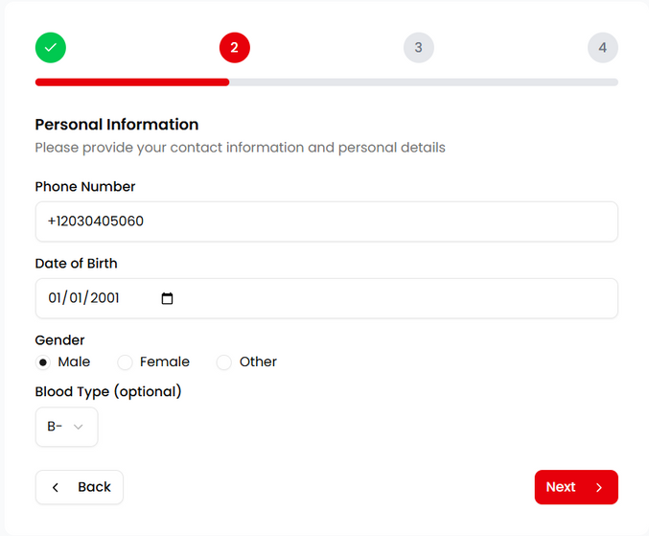
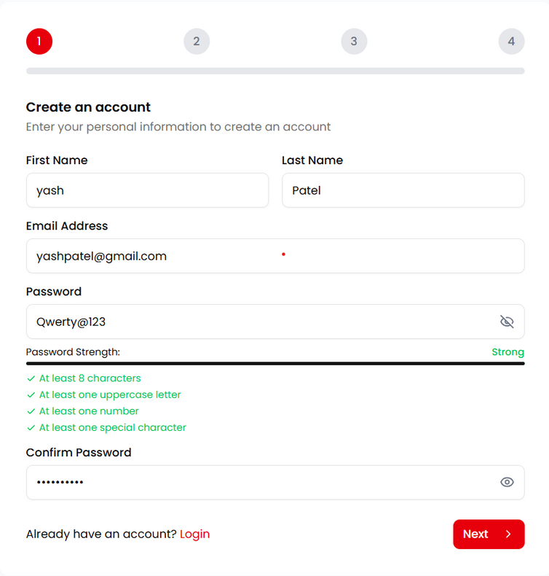
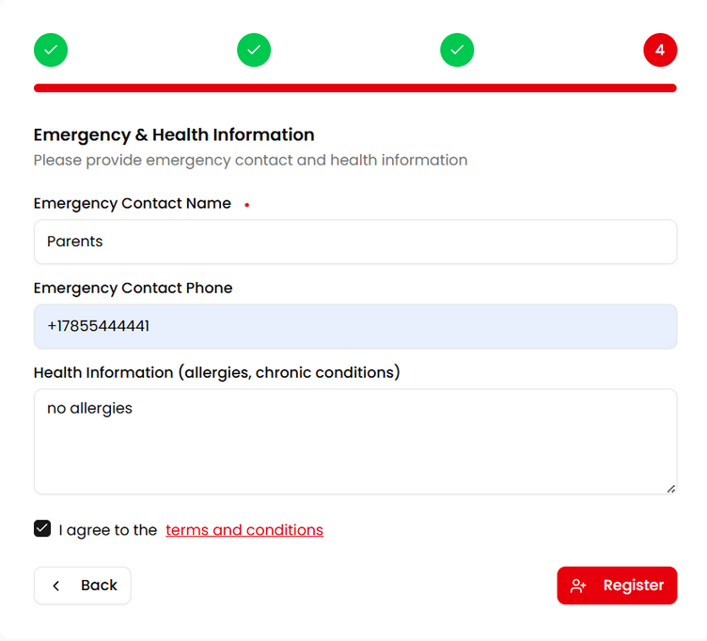
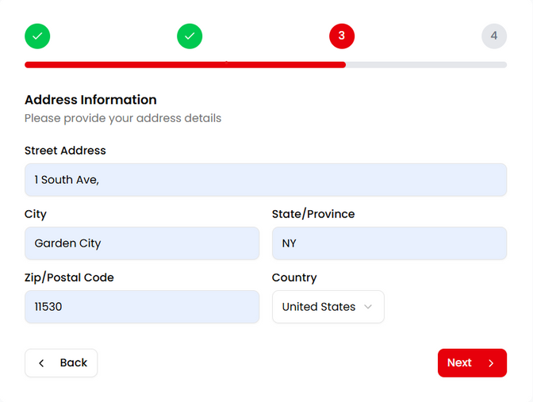
Register Page

Slide 10
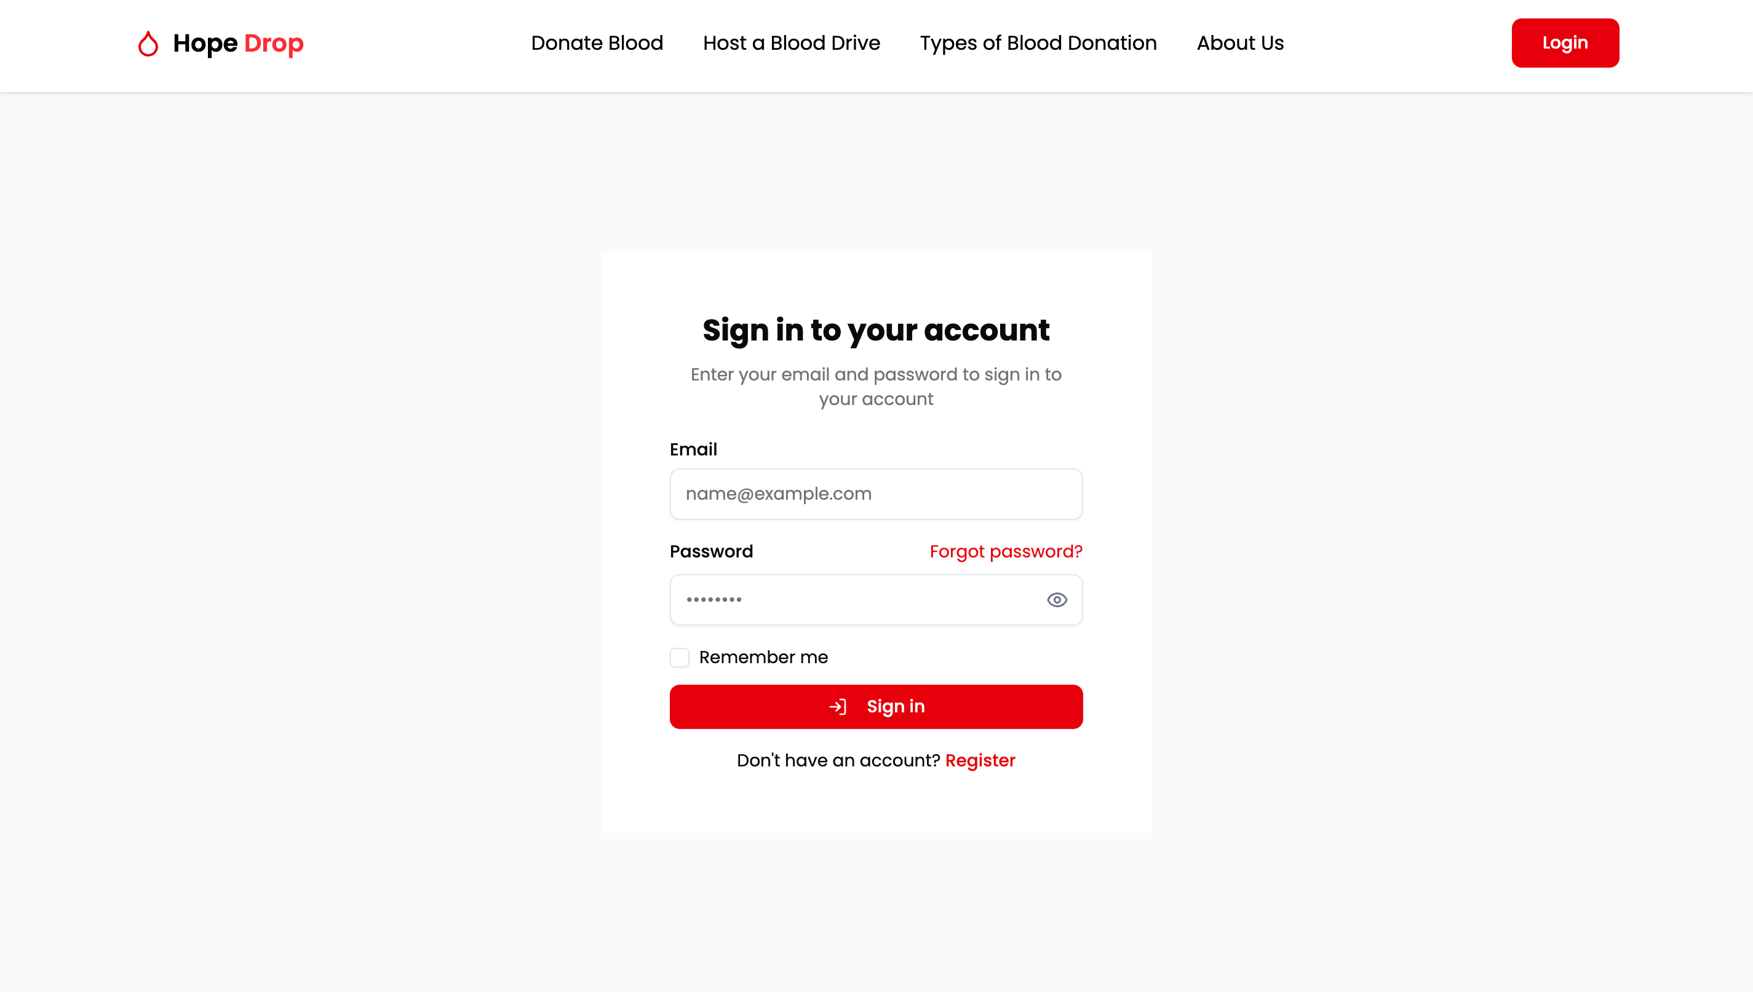
Login Page

Slide 11
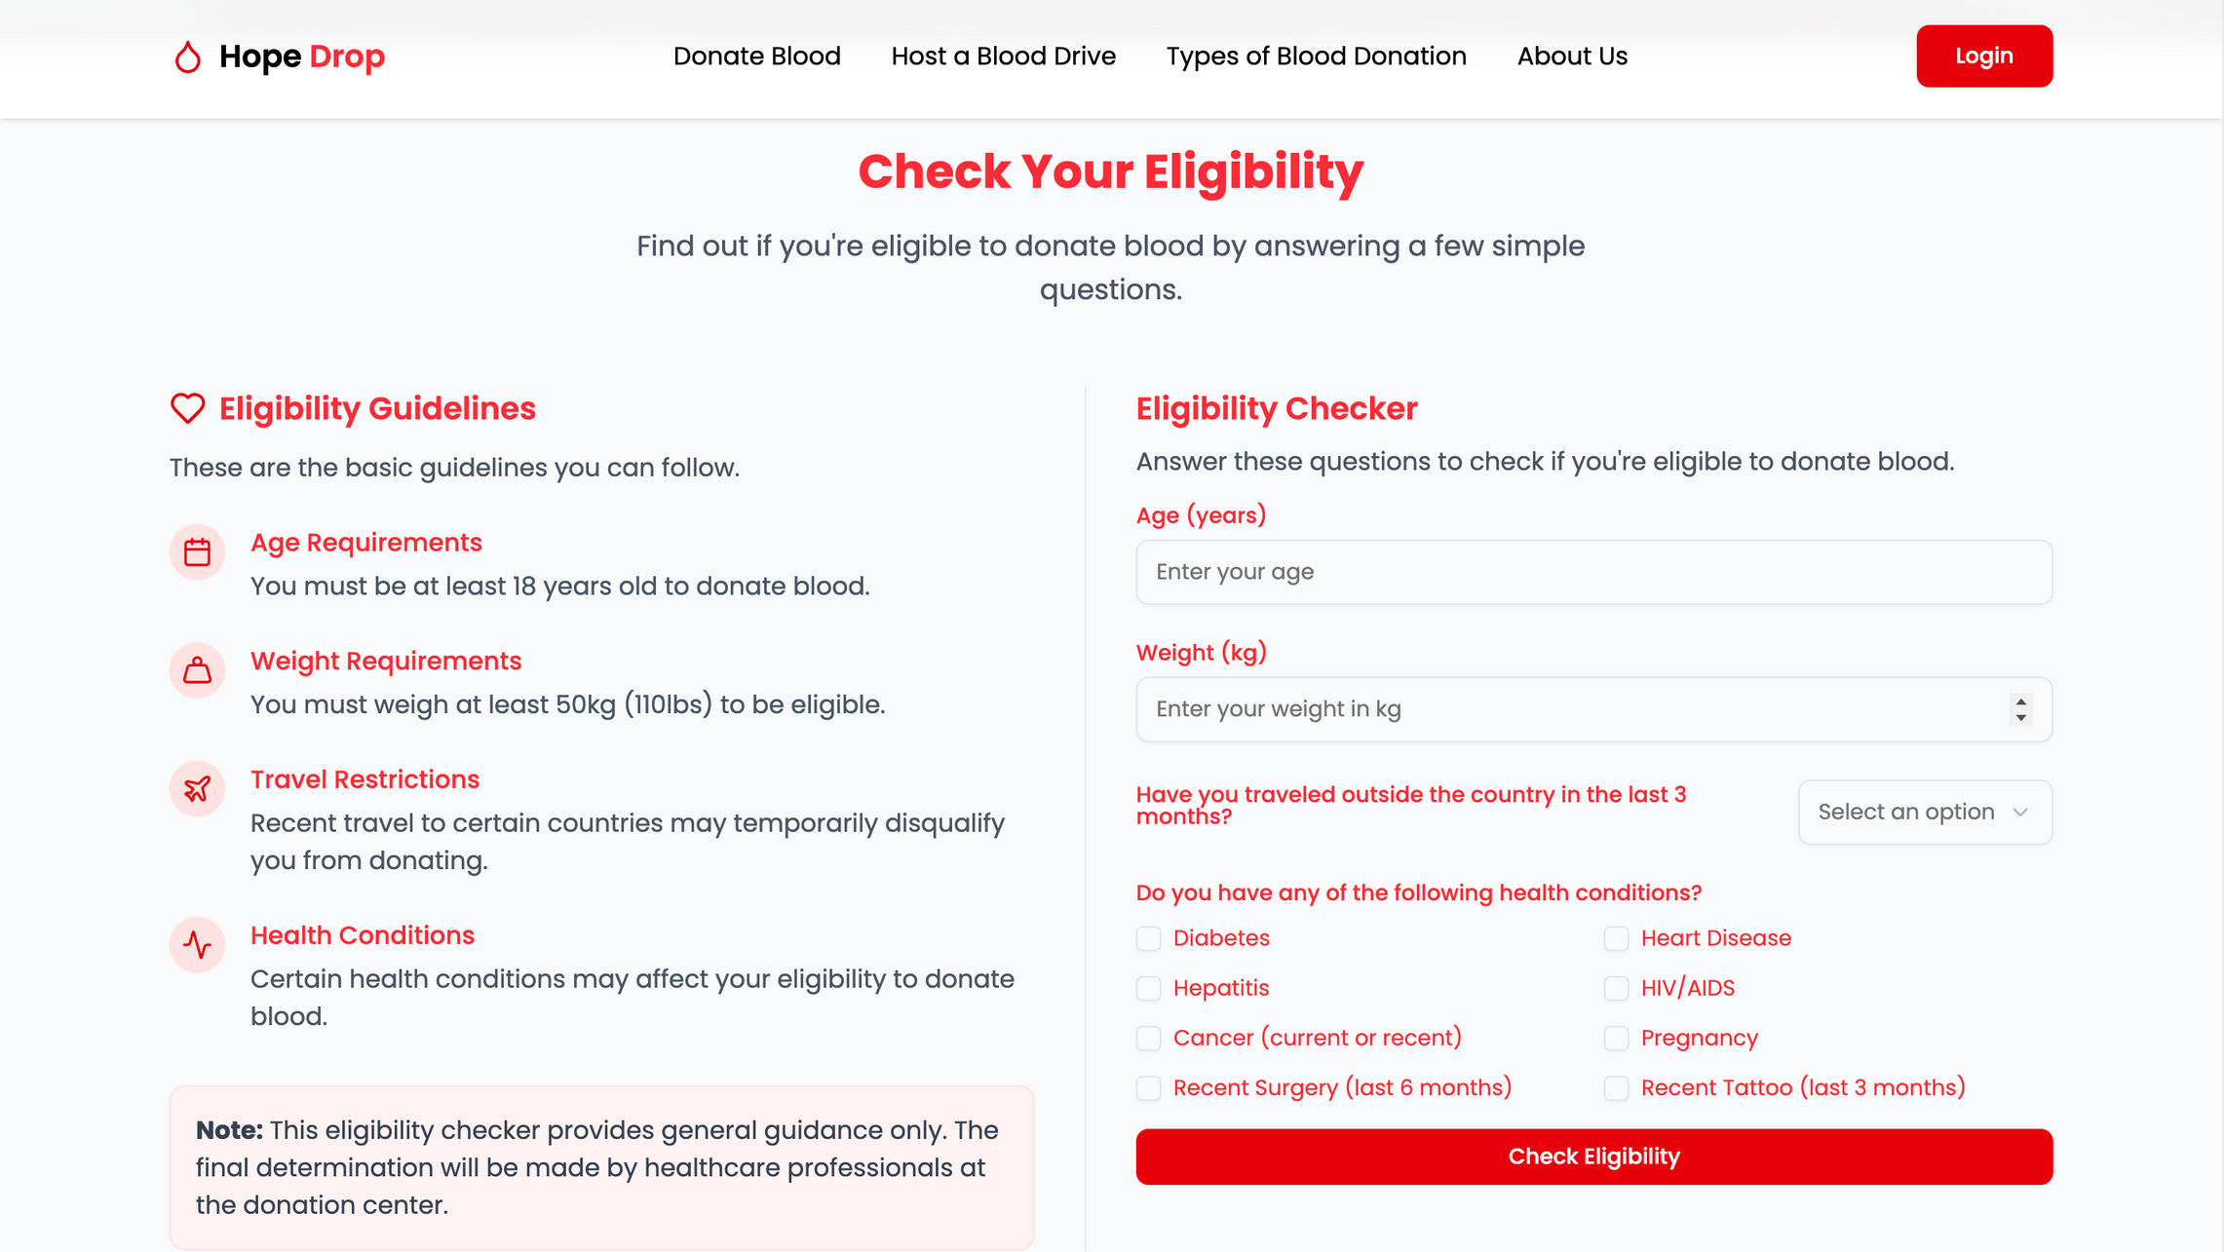
Check Your Eligibility

Slide 12
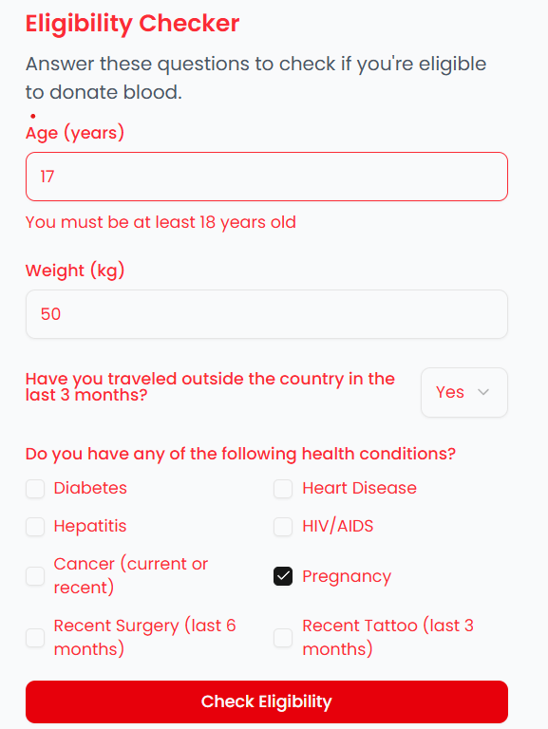
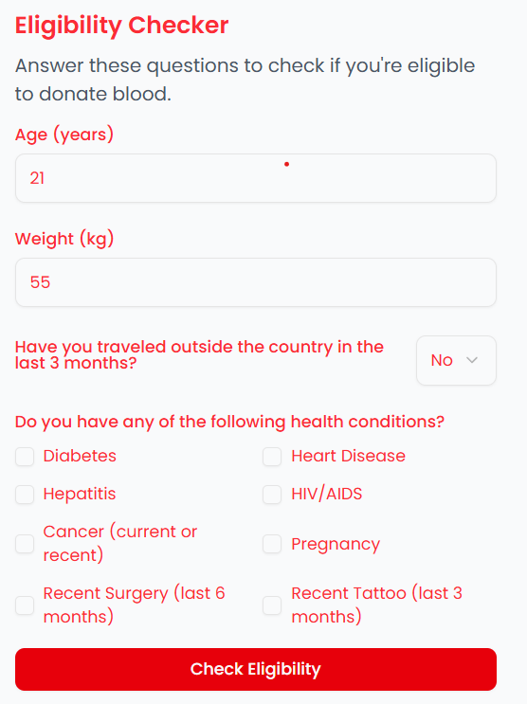
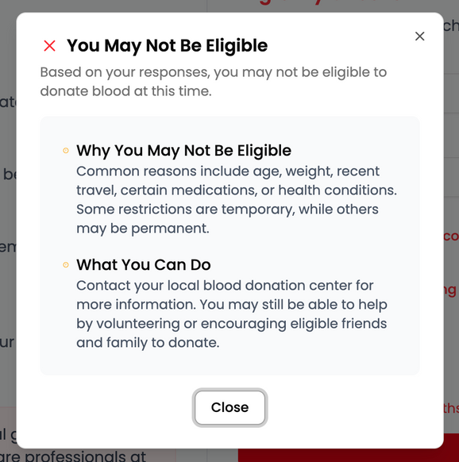
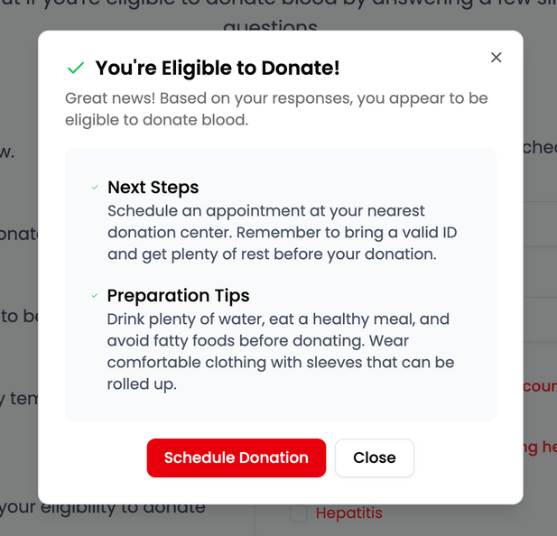
Eligibility Criteria
Not Eligible
Eligible

Slide 13
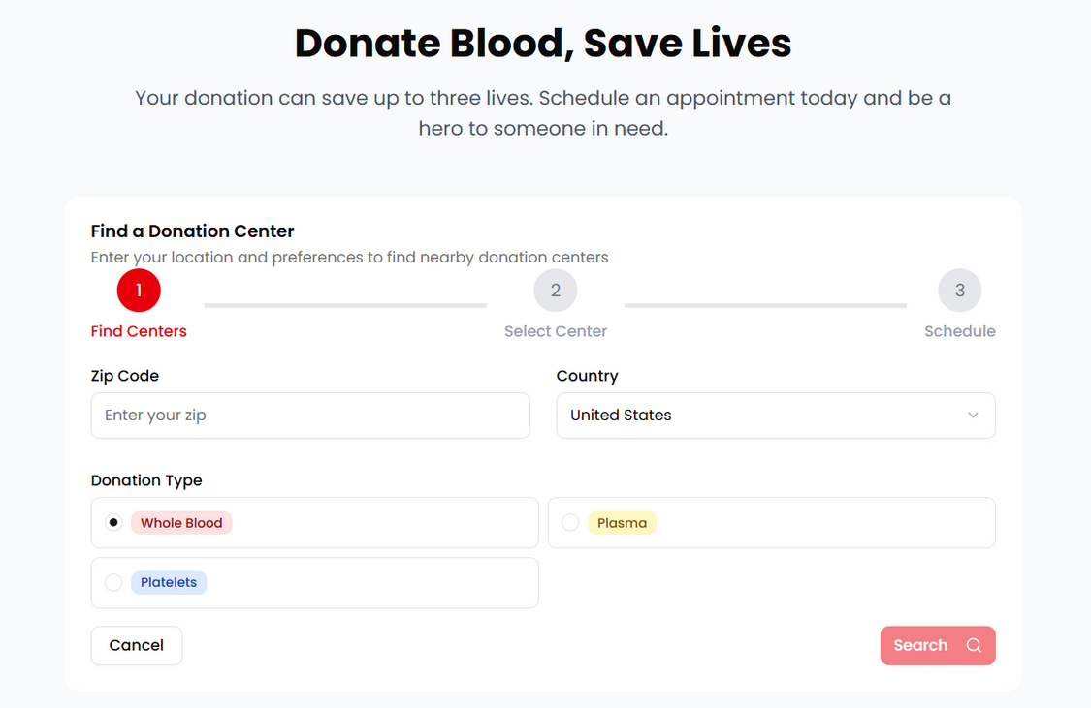
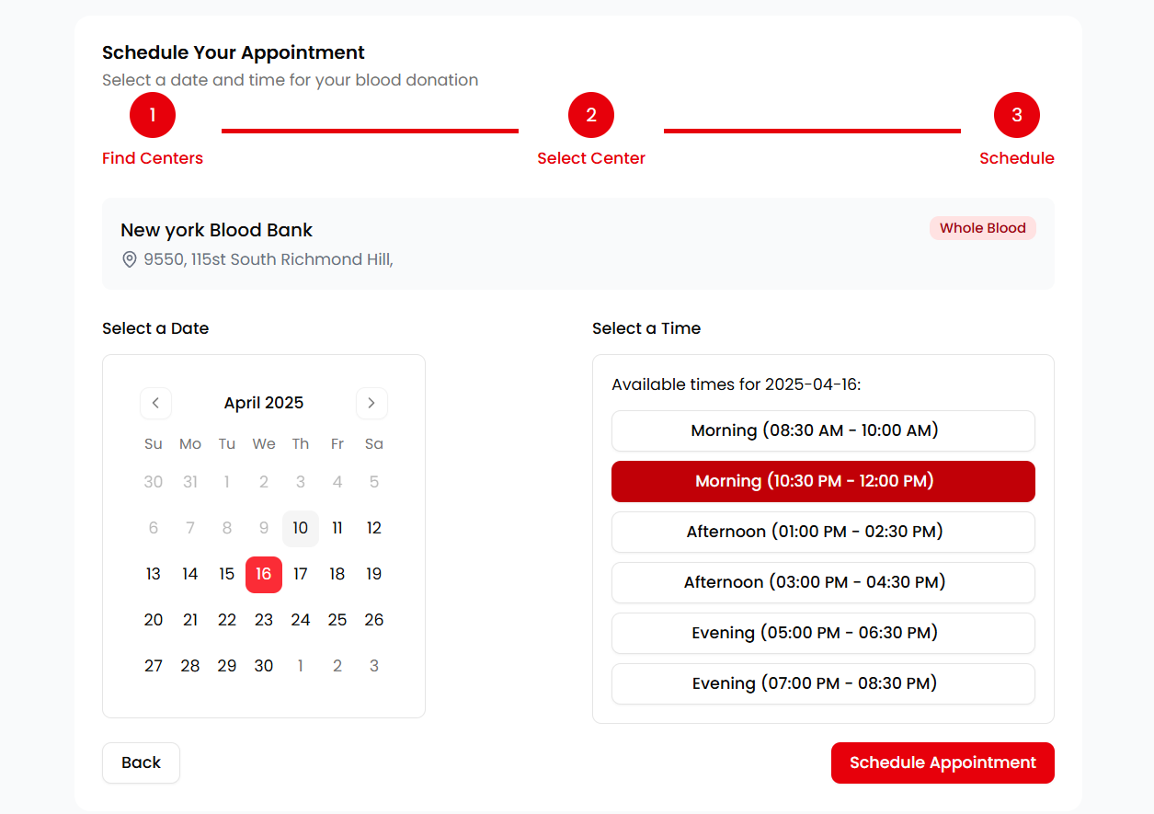
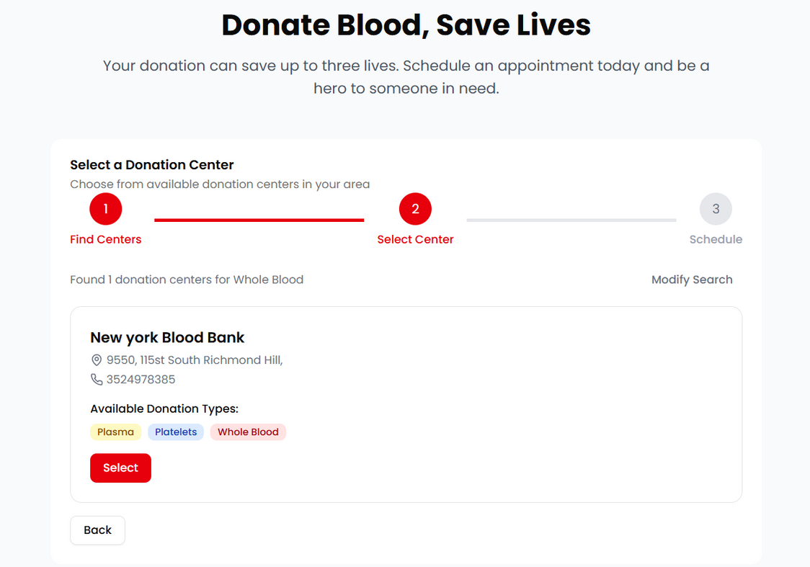
Donate Blood

Slide 14
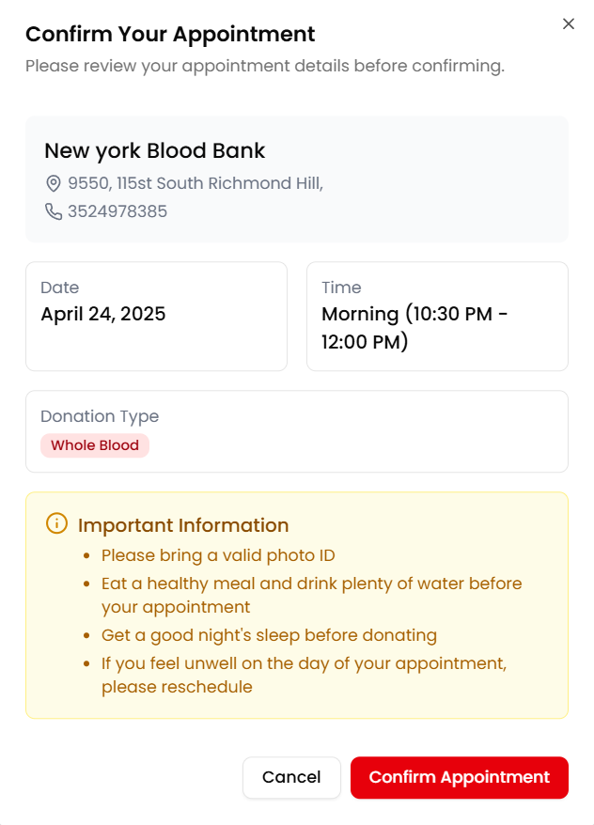
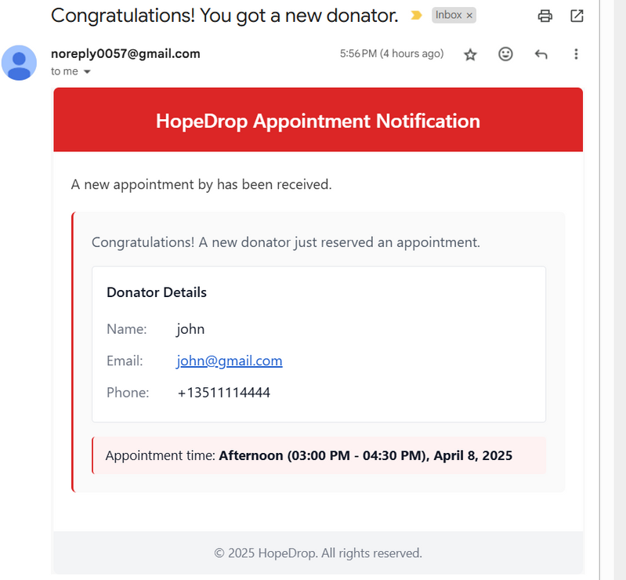
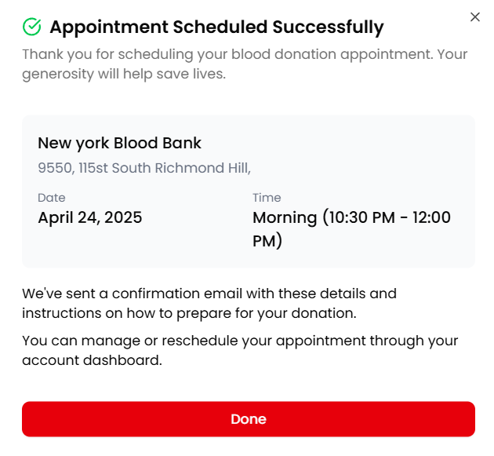
Donation Confirmation

Slide 15
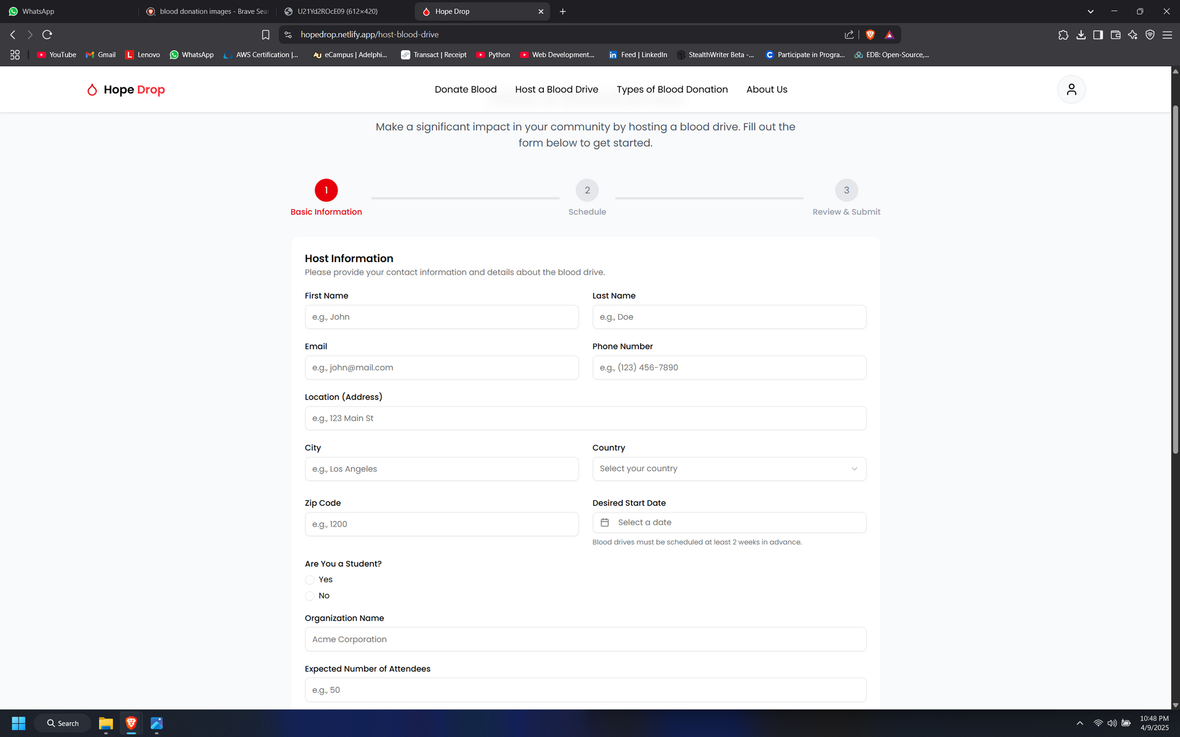
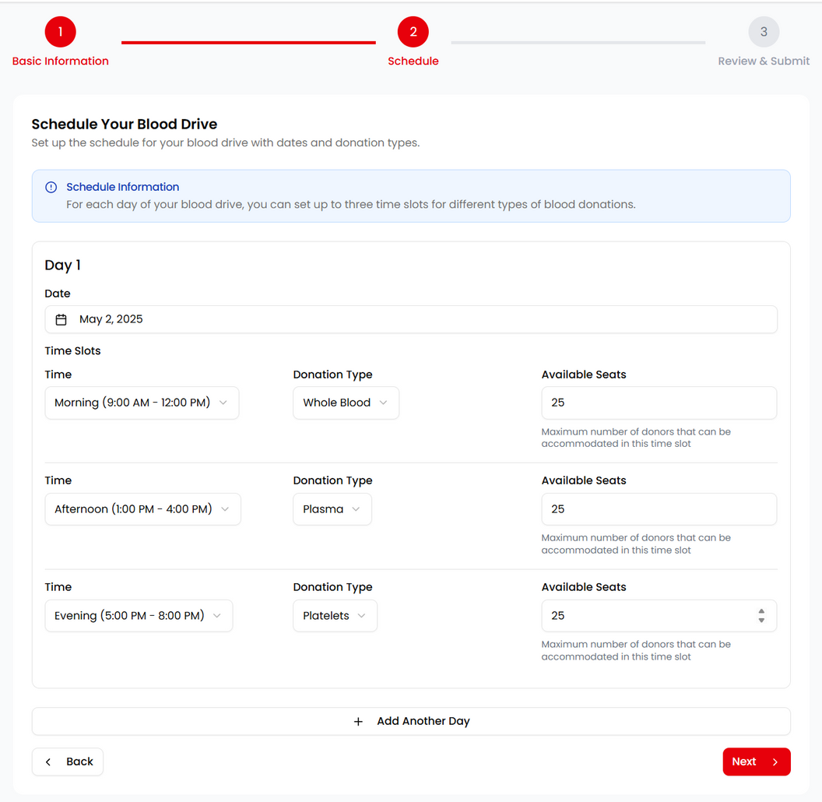
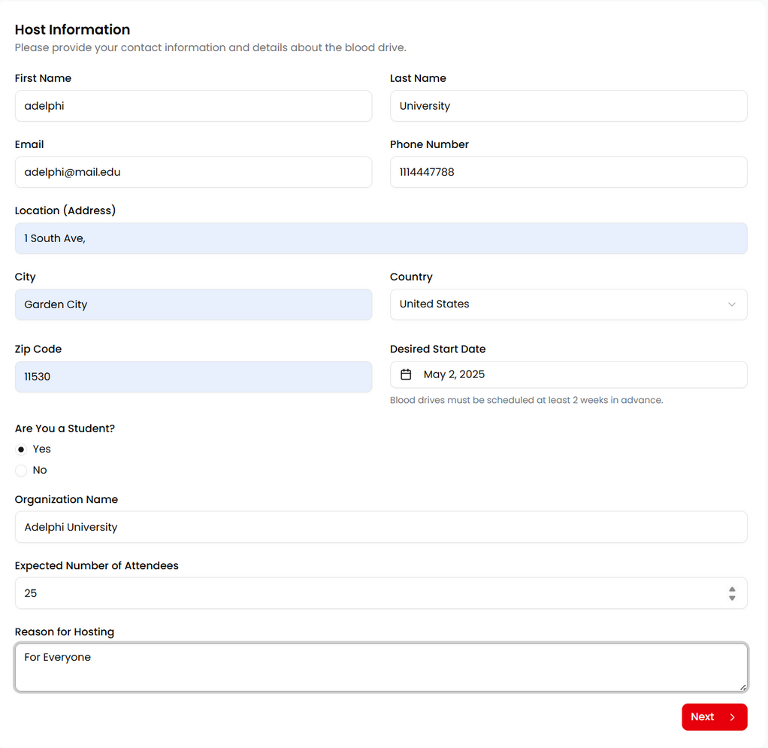
Host A Blood Drive

Slide 16
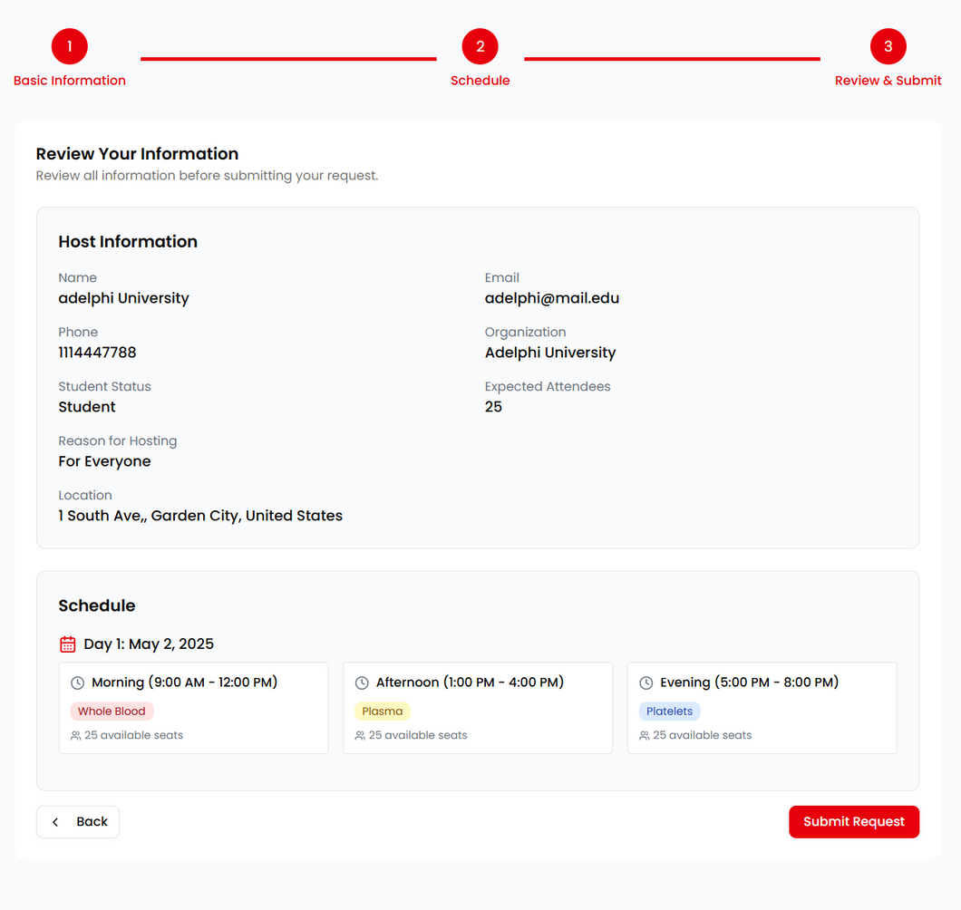
Host A Blood Drive

Slide 17
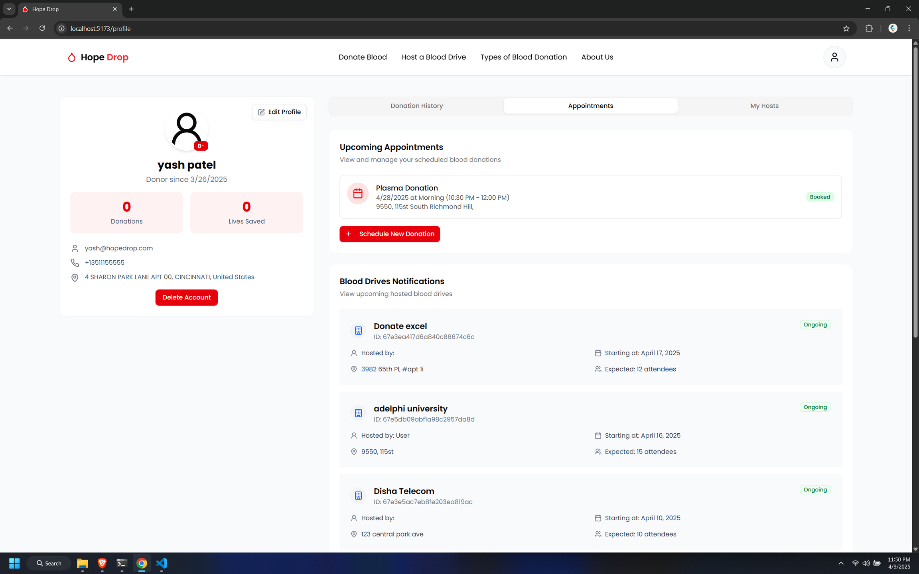
Profile Page

Slide 18
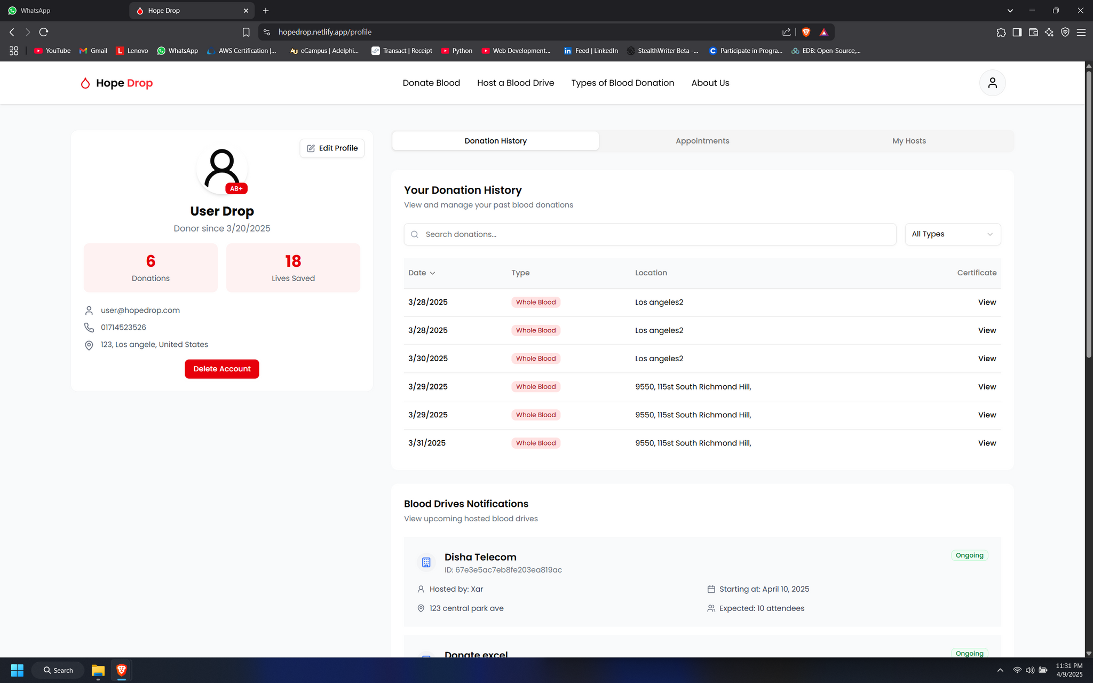
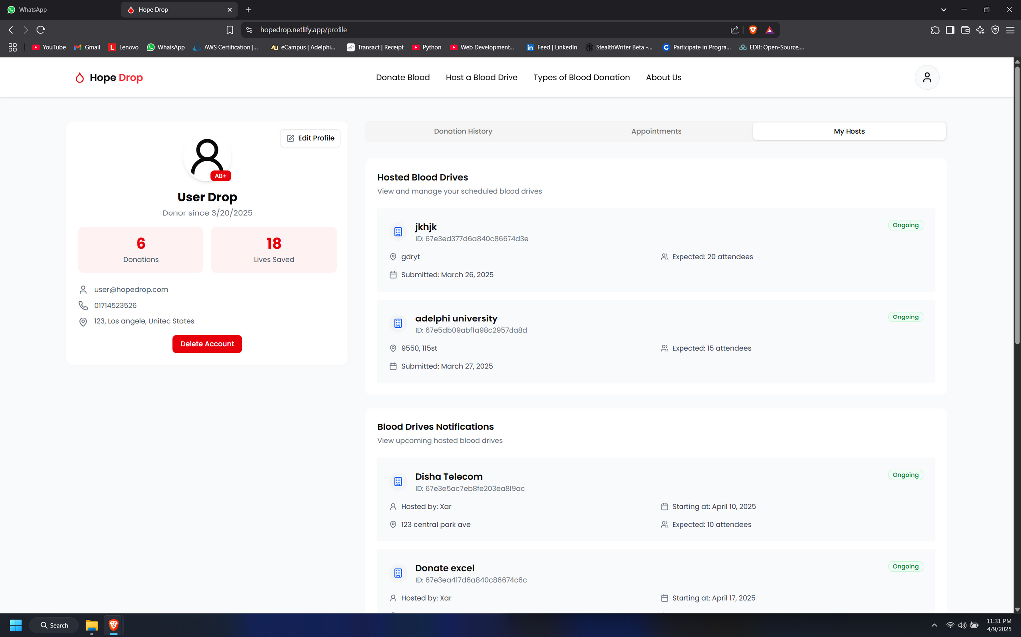
Profile Page

Slide 19

Core Functionalities
Admin Features
Dashboard Overview
Approve or Reject Blood Drive Requests
Generate Donation Certificates for verified donations.
Manage Donation Centers

Slide 20
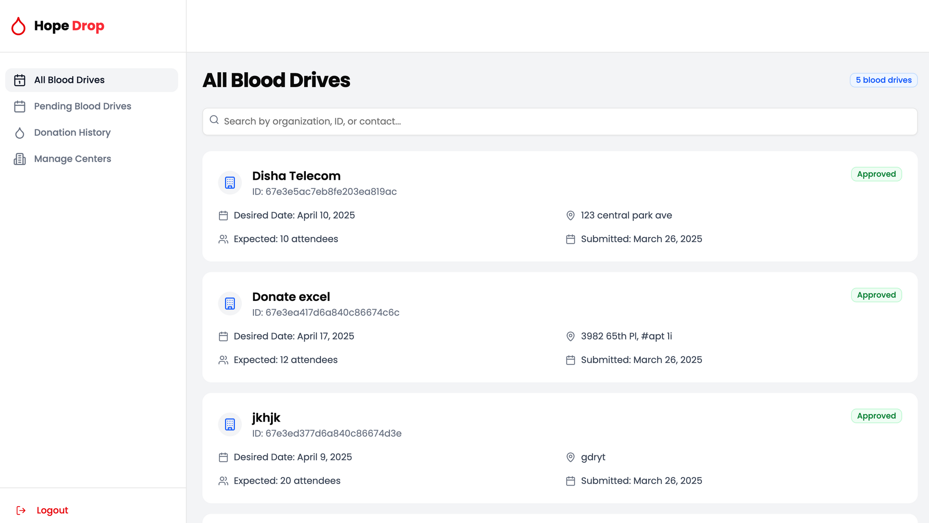
Admin Dashboard

Slide 21
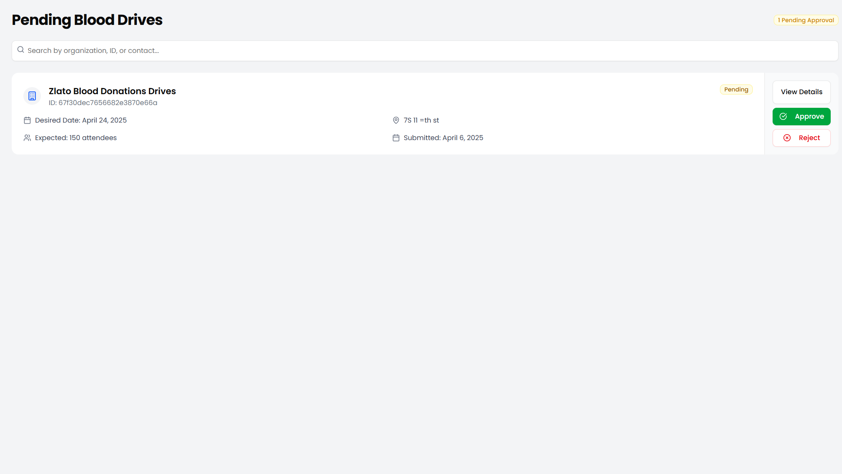
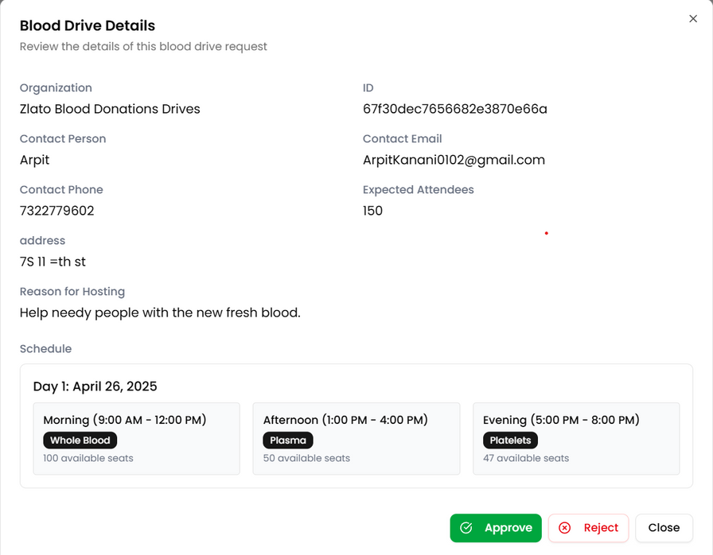
Pending Blood Drives

Slide 22
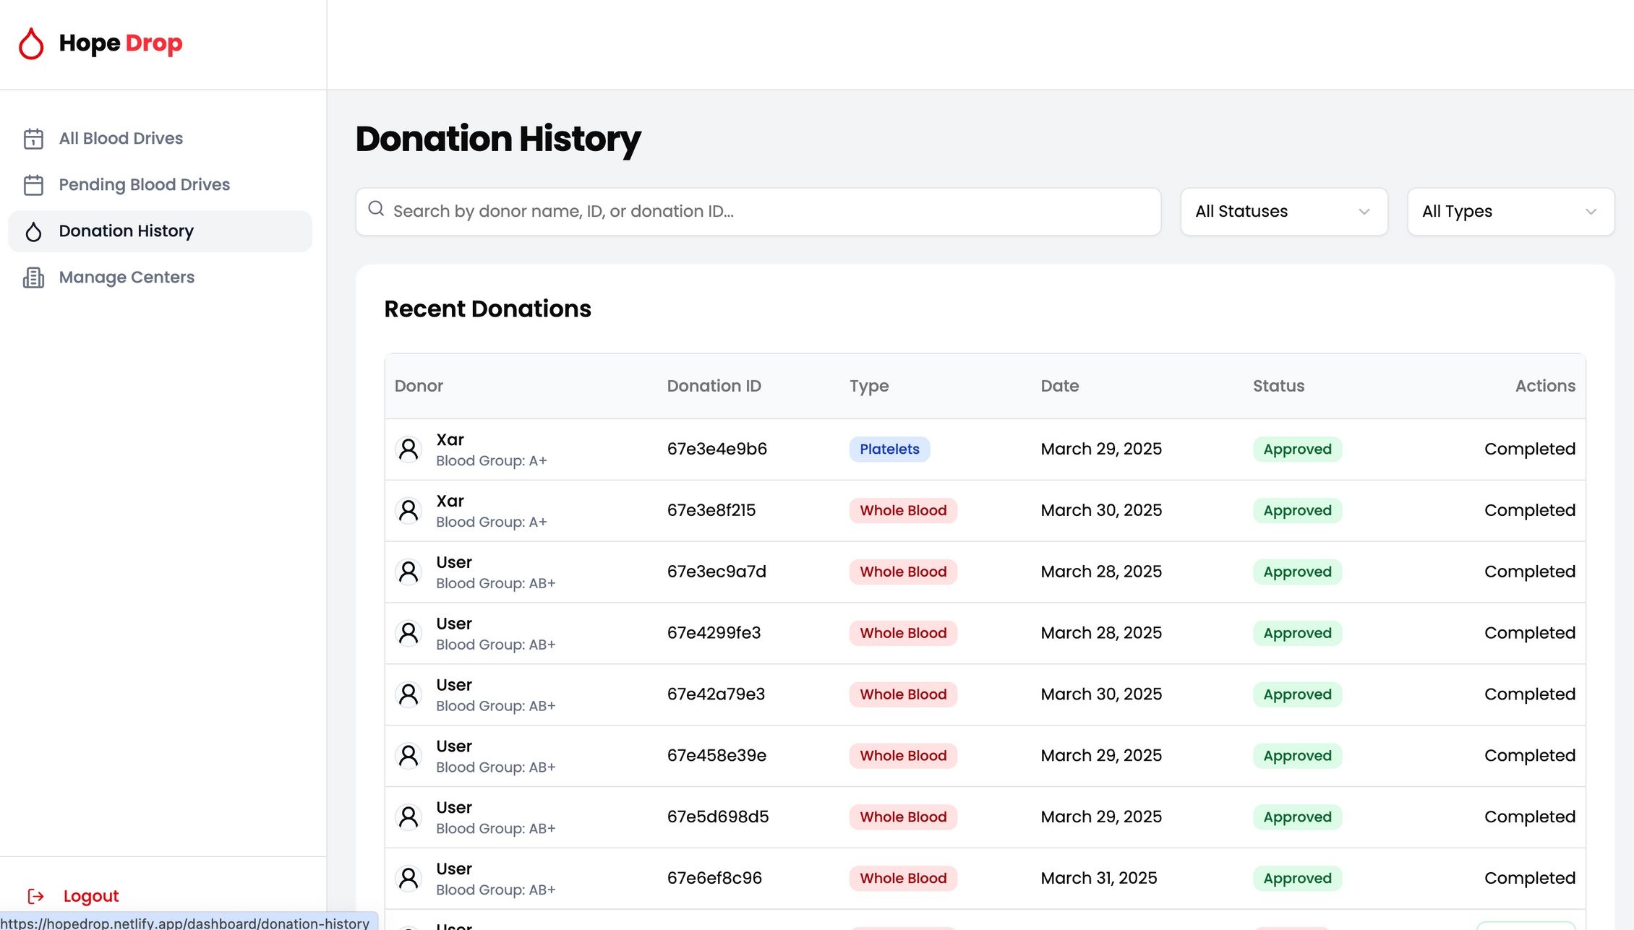
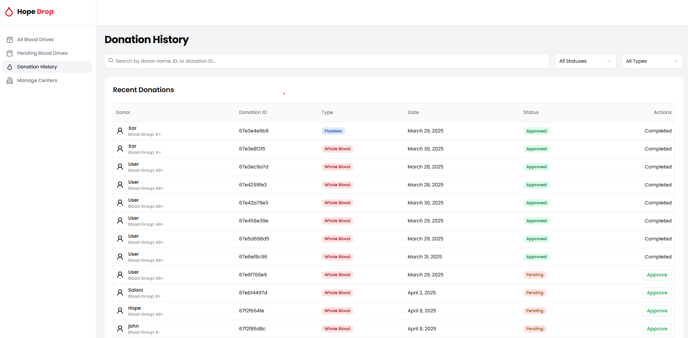
Donation History

Slide 23
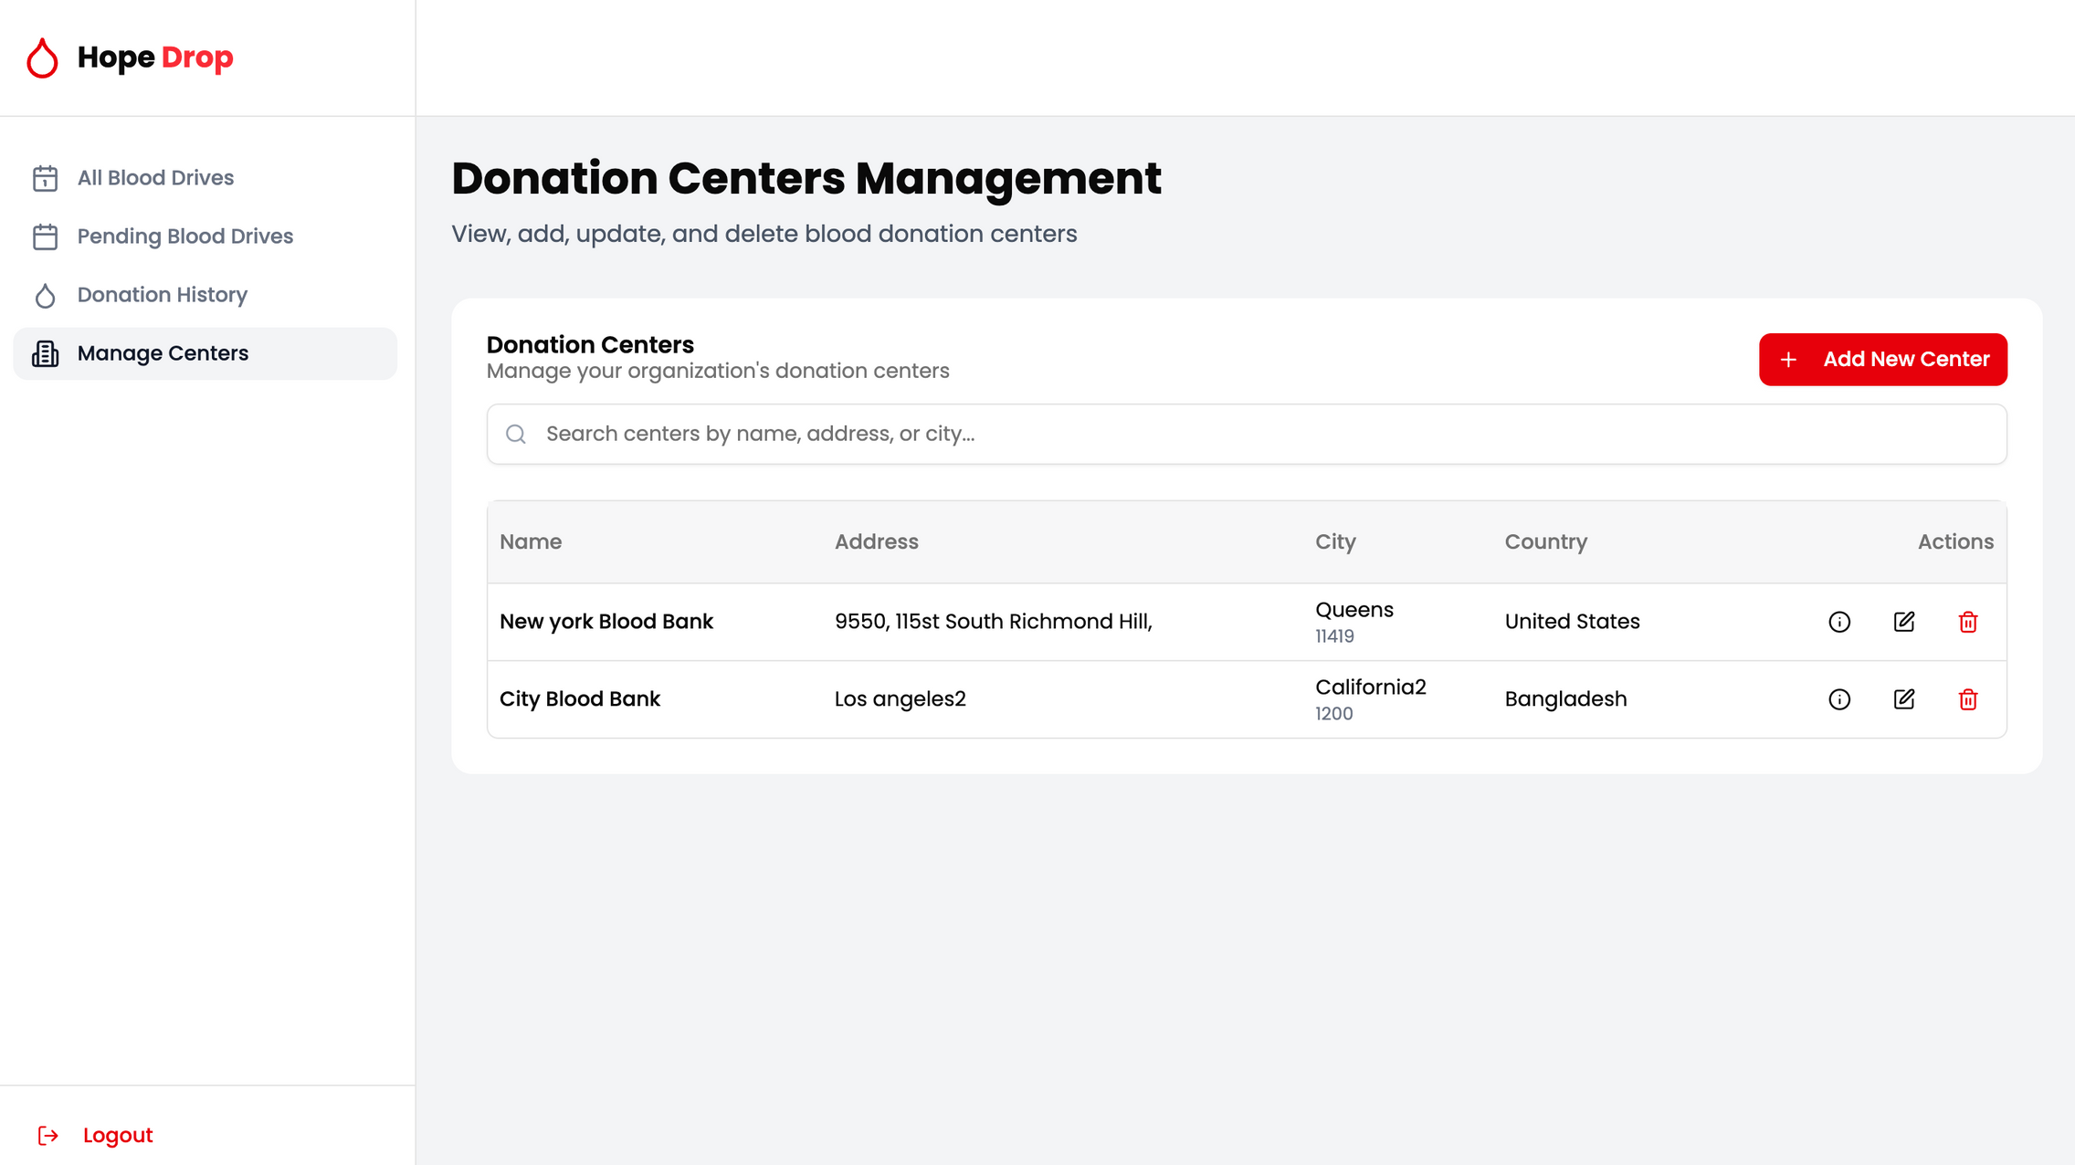
Donation Centers Management

Slide 24

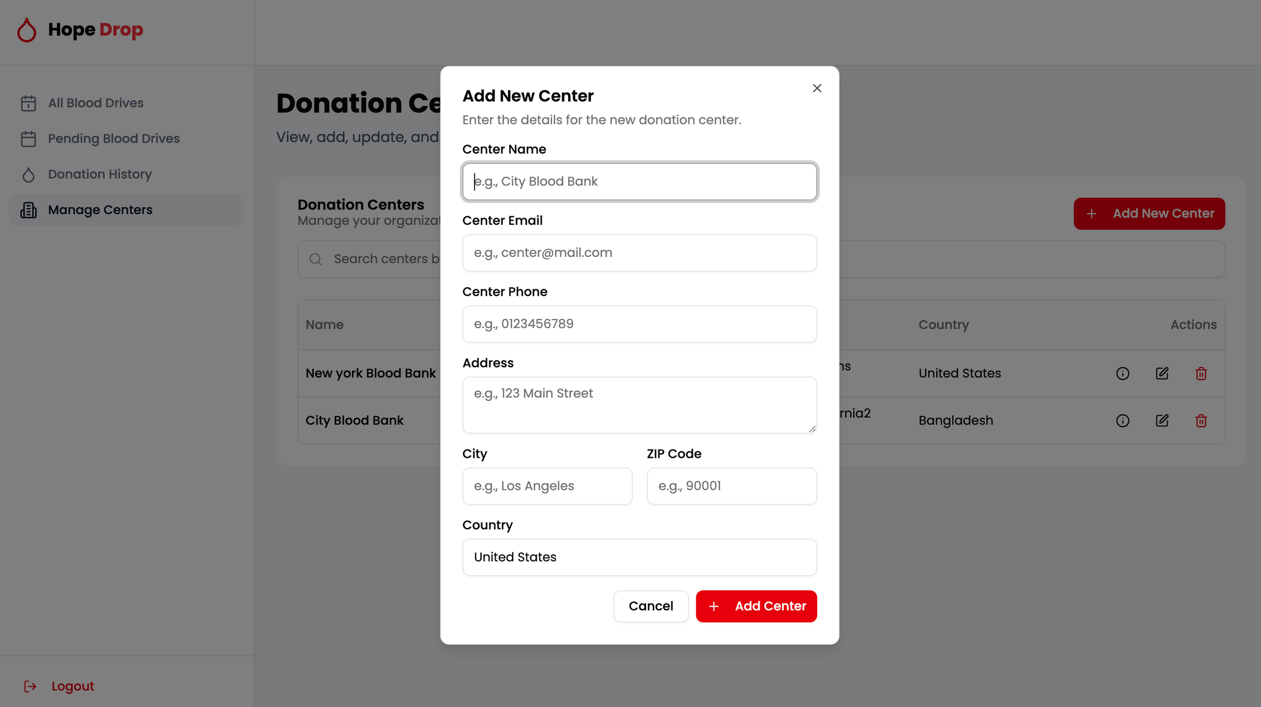
Add New Center

Slide 25
Future Enhancement
Hospital Management Page
This feature will allow hospitals and healthcare administrators to efficiently manage donor appointments, monitor blood inventory levels, oversee blood drive participation, and handle staff assignments. The dashboard will provide real-time data, alerts, and administrative tools to streamline hospital-side operations within the HopeDrop system.
User Management System in Admin Dashboard
The User Management System in the Admin Portal allows administrators to view, edit, and delete user records, ensuring accurate donor information and platform integrity. It provides full control over user roles and activity monitoring for secure and efficient management.
Emergency Blood Request System
This feature allows users or hospitals to post urgent blood requirements by specifying the needed blood type, location, and contact information. Registered donors near the request location are notified instantly through email or in-app alerts.
Advanced Analytics Dashboard
Adding a detailed analytics dashboard for both admins and hosts can provide real-time insights into donation metrics, demographic statistics, donor retention, and performance indicators across regions or time periods. These analytics can be visualized using dynamic charting libraries.

Slide 26

Conclusion
HopeDrop is a secure, user-friendly web platform that connects donors, organizations, and healthcare personnel. It features live event scheduling, donor record monitoring, and role-based access, ensuring efficient and transparent blood donation management.
The platform strengthens donor engagement, enhances blood drive organization, and promotes community-based donation practices. With features like emergency request automation, predictive analysis, and extended outreach, HopeDrop aims to amplify its global impact on blood donation efforts.

Slide 27






Thank You for your attention
Question?

